Slide 1
Enhanced Leak Localization in Headphones through Beamforming and 3D Modelling
Intro to the measurement system
Zhengmeng Li
Supervisor:
Wookeun Song
Vicente Cutanda Henriquez

Slide 2
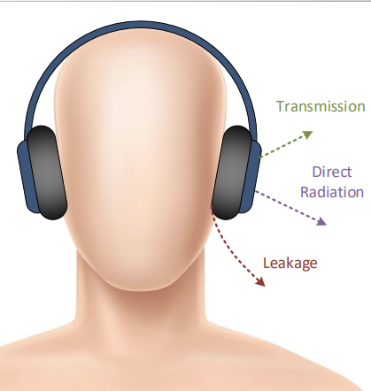
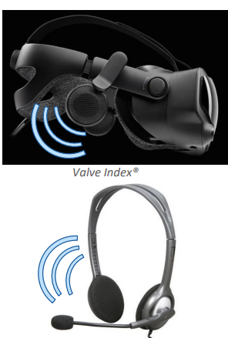
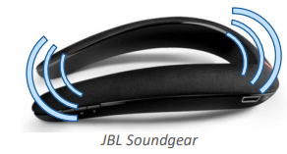
Motivation
This measurement system is mainly focus on the leakage, which can be described as the "unwanted sound radiation from the device". But it can be utilized in a more general scenario, e.g., for characterizing the radiation pattern from open-headphone/TWS/VR or AR's loudspeakers.
Why we need to identify sound leakage:
Privacy of content and communication
Disturbance in calm environment like work space
Undesired feedback to microphones in duplex mode (echo)
Impairment of microphone input based DSP algorithms
VR/AR or smart glass's intentional radiation

Slide 3
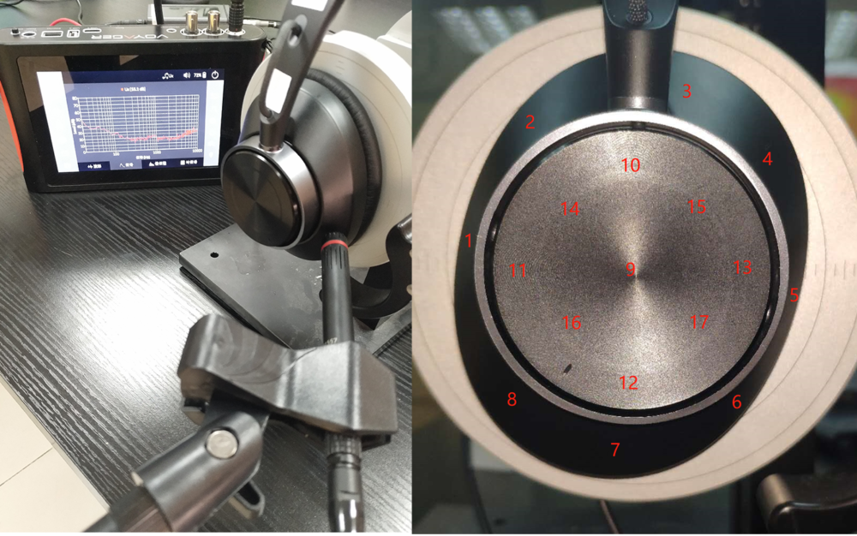
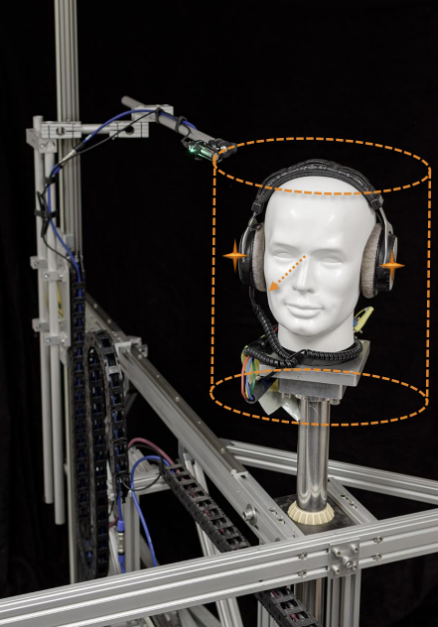
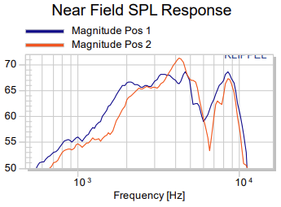
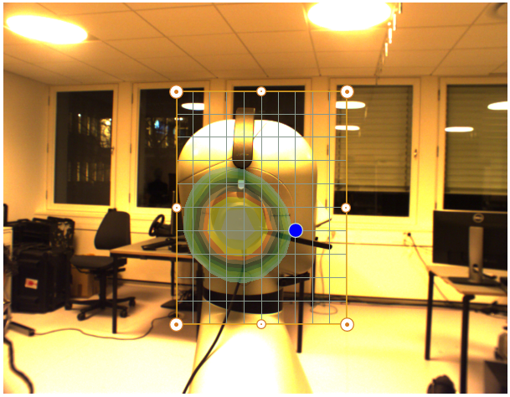
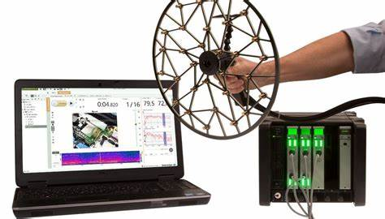
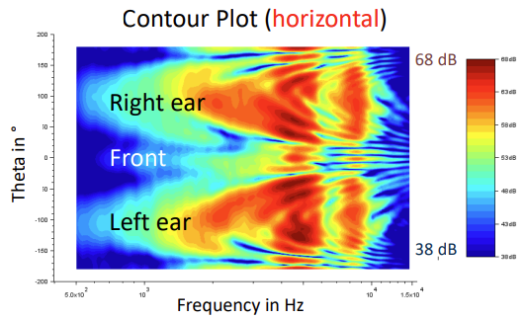
Motivation
Current solution for sound leakage identification:
Conventional Near field measurement (example on the left)
Single moving microphone - radiation directivity (example on the right)
Microphone array – 2D beamforming (example below)
Meng, Fanyu, Anbo Yu, and Dani Fernandez. "Sound leakage investigation of ANC headphones using particle velocity sensors." INTER-NOISE and NOISE-CON Congress and Conference Proceedings. Vol. 261. No. 6. Institute of Noise Control Engineering, 2020.
Workshop 3d Directivity Data in Headsets and Hearables - R.Werner (KLIPPEL GmbH) - online

Slide 4
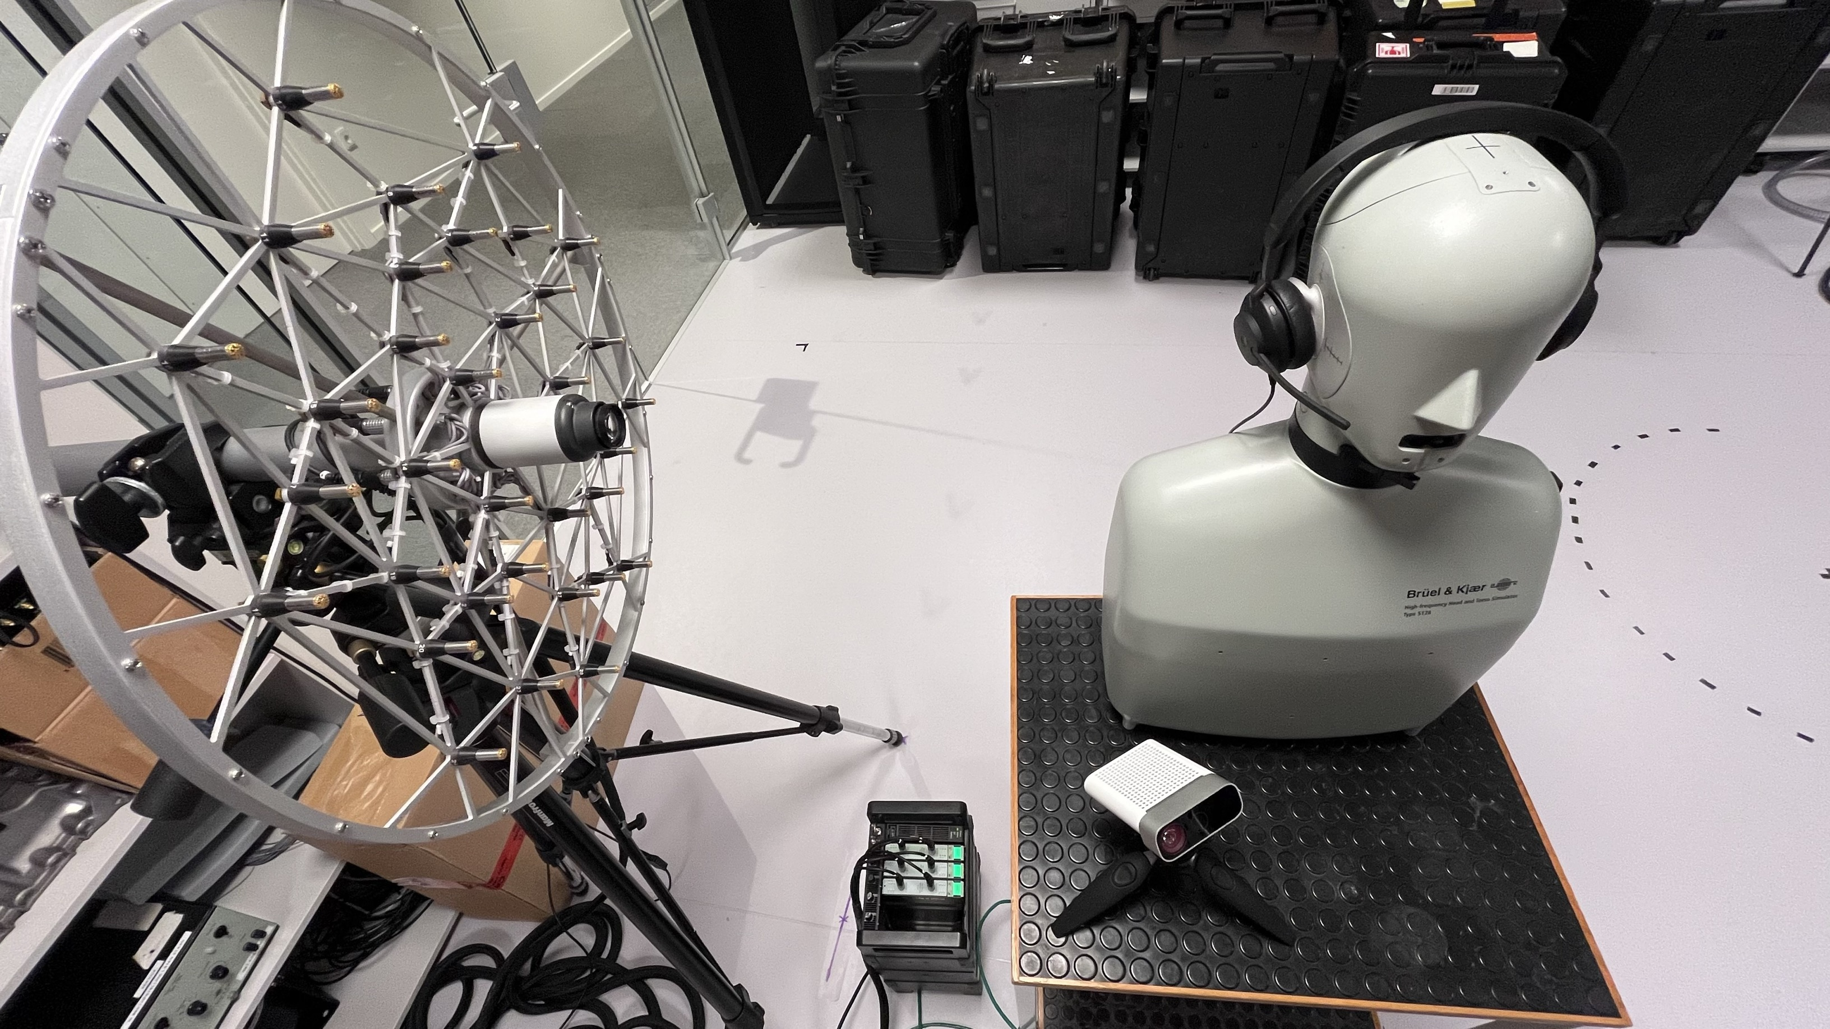
Intro to the system – physical components
Acoustic Array. Channel: 36
Diameter: 45
Device under test, with HATS wearing it.
Microsoft Azure Kinect
Lan-XI front-end

Slide 5
Process flow
Lidar scanning
Geometry alignment
Mesh create
Scanner: kinfu_example.exe
Geometry processor: pcd_align_app.ipynb
Output: original geometry point cloud, cropped pointcloud, and micarray location
Grid distance
Cross spectrum matrix, point spread function, and steering vector
Beamformer: DAS/MUSIC/
CLEAN-SC
Calculator: 3dbf_app.ipynb
Beamformer: Acoular (github)

Slide 6
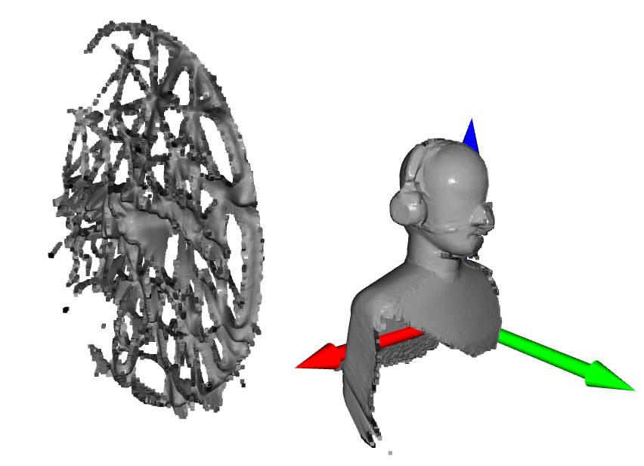
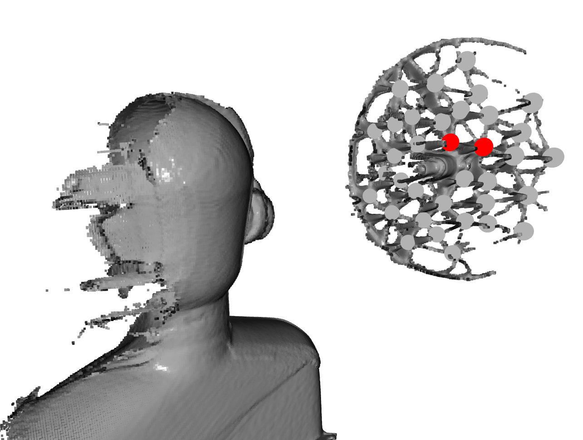
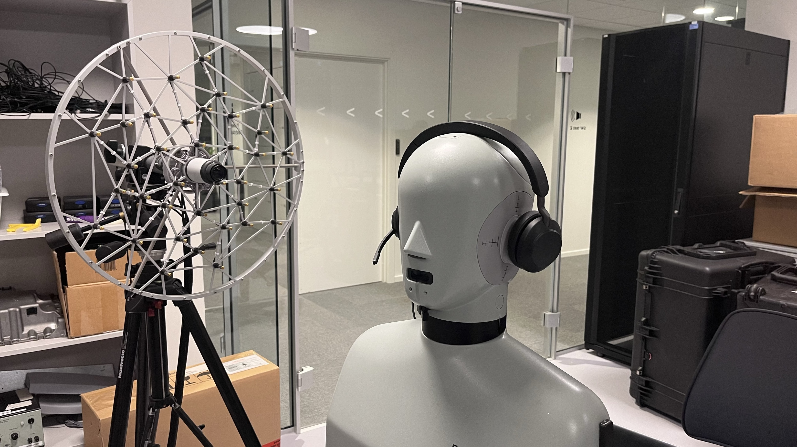
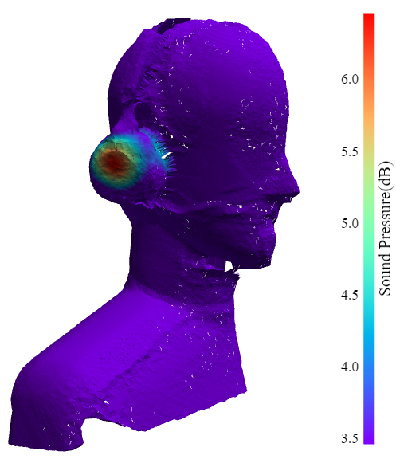
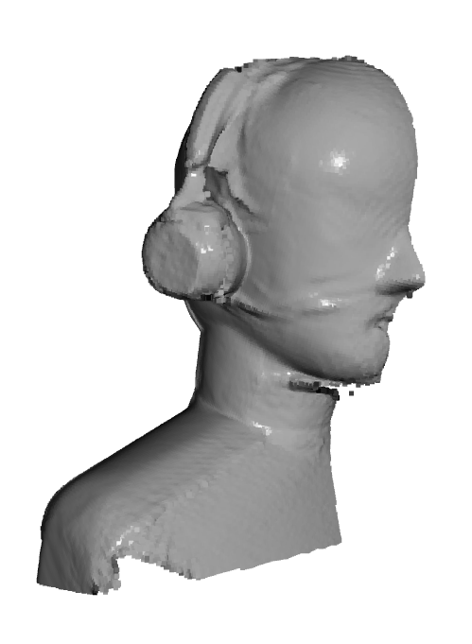
Process flow
Resolution: 0.5mm
Time consumption: 20mins
Alignment accuracy
Minimal distance from subject to array
Subjects list:
Jabra evolve2 75
Jabra evolve2 65 flex

Slide 7
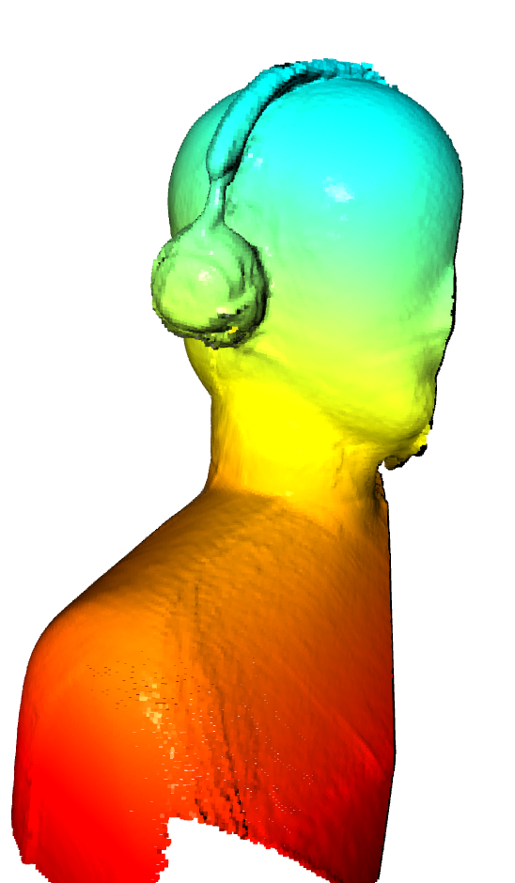
Intro to the system - mechanism
Geometry creation
Lidar scanning (with Microsoft Azure Kinect)
After the lidar scan, the surface of the object can be represented by point cloud and mesh.
togther with scanning of the surface, the microphone array will also be scanned, hence it's relative position to the object surface can be obtained in the same coordinate.
Sound field reconstruction
Recording by Acoustic Array, then the sound field can be reconstructed by Beamforming.
Based on the geometry information collected by Lidar scanning, the sound pressure/power at object's surface can be obtained. (instead of conventional planar Beamforming)
Rather than DAS beamforming, some Advanced algorithm can be utilized, in order to obtain a higher spatial resolution

Slide 8
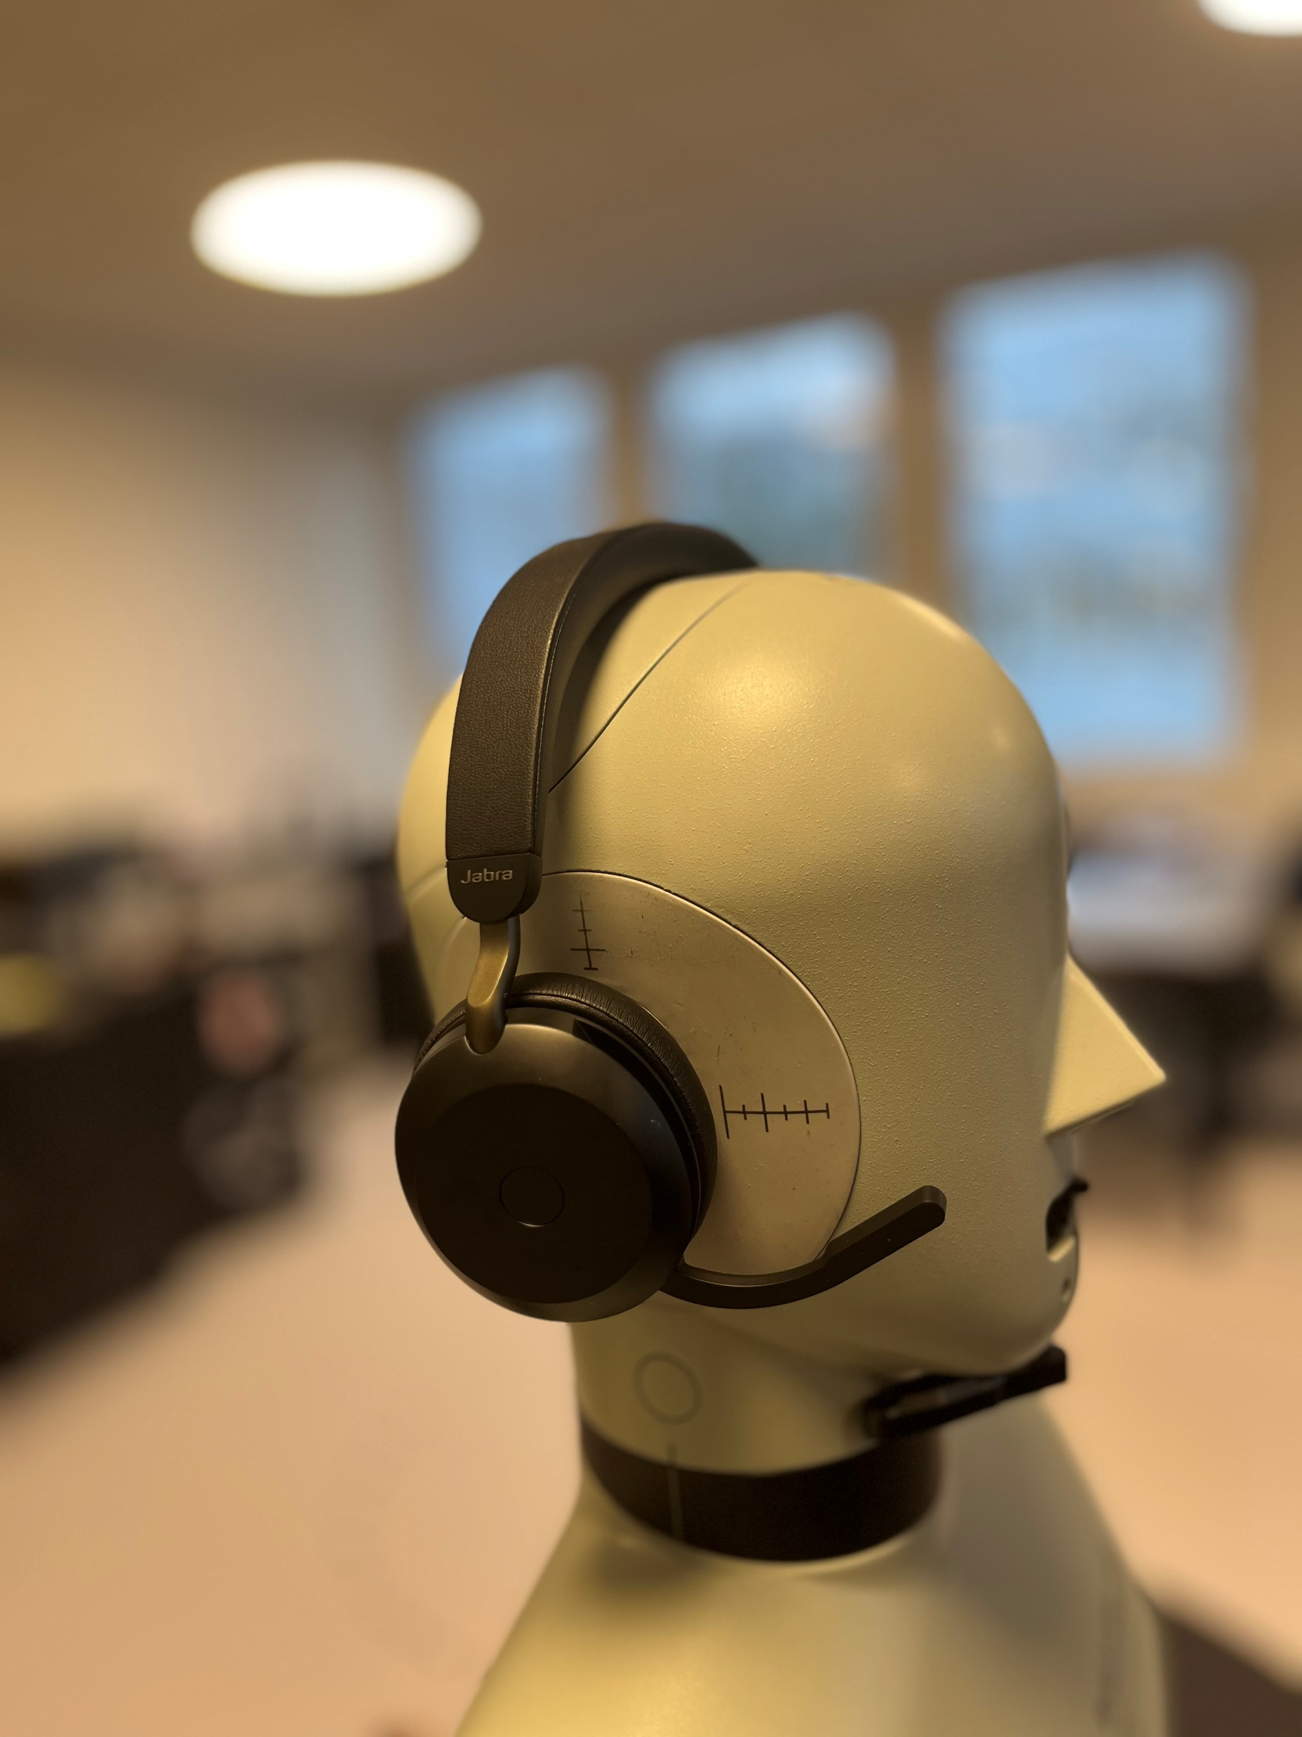
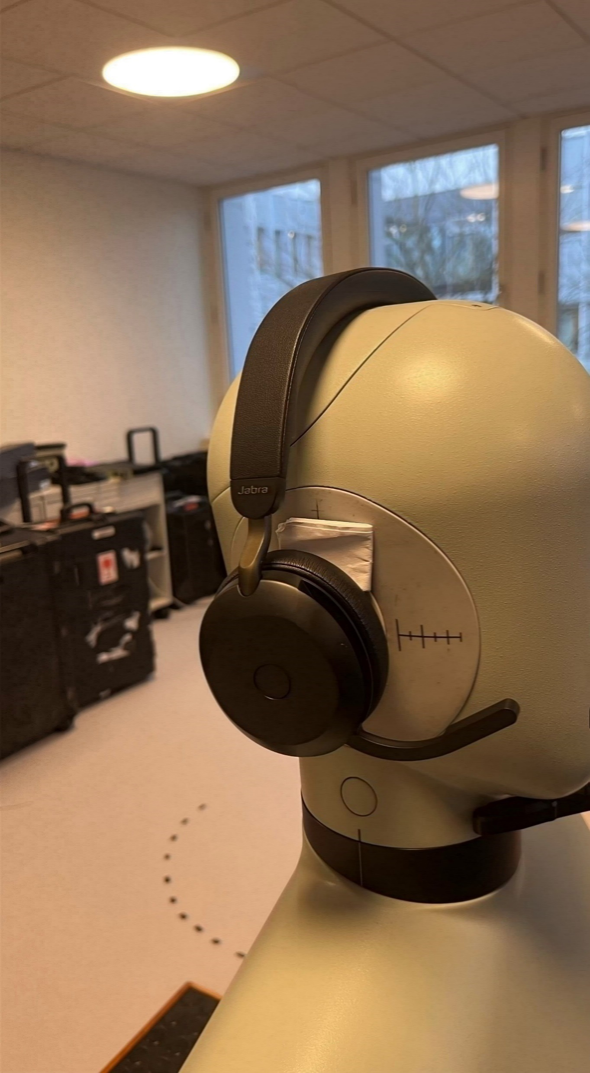
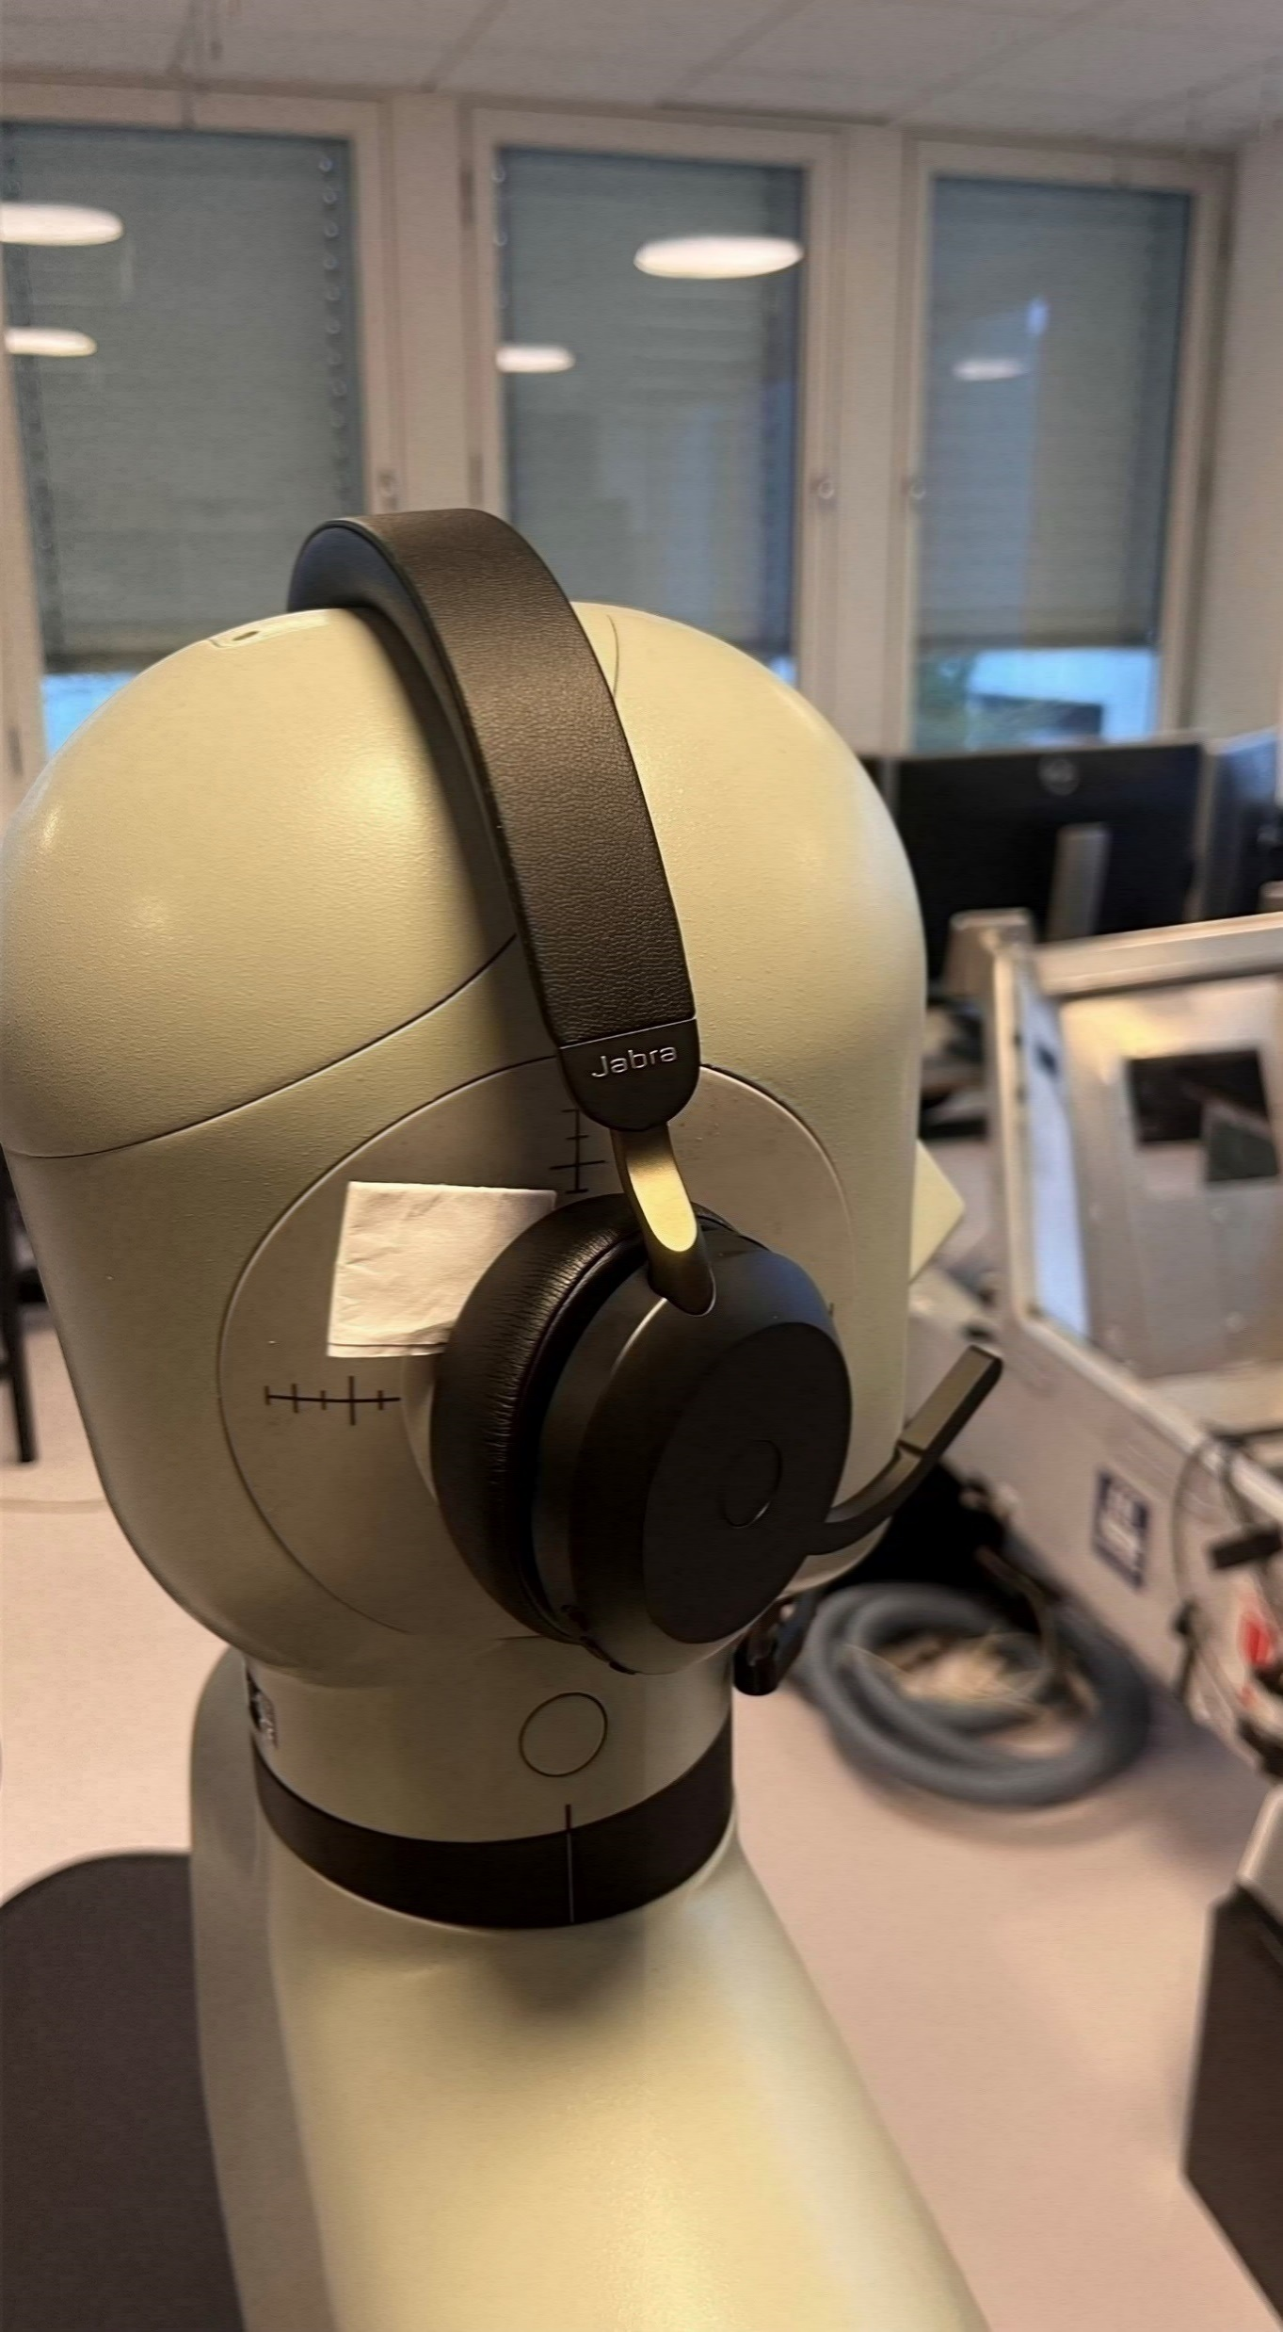
Measurement results - configuration
Subject: Jabra evolve2 75
Frequency: [1kHz, 2kHz, 3kHz, 6kHz, 8kHz], 1/3 octave band
Measured frequency range: 50Hz – 10kHz,
Test condition: good fitted, front lose, back lose

Slide 9
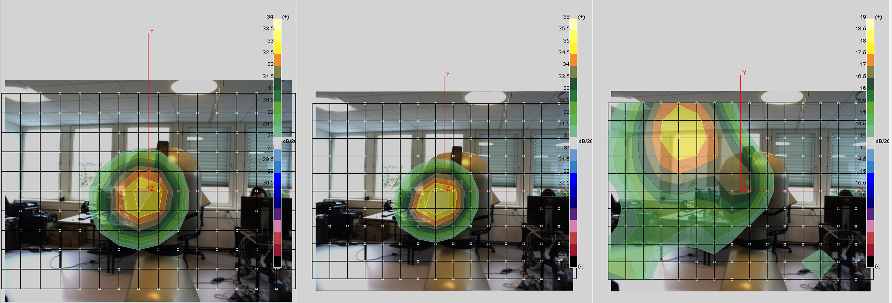
Measurement results - 2d beamforming
Result from NSI array postprocessing
DAS beamforming center at 3150kHz, 1/3 octave bandwidth
Plot with 5dB dynamic range
Back Lose fit
Front Lose fit
Good fit

Slide 10
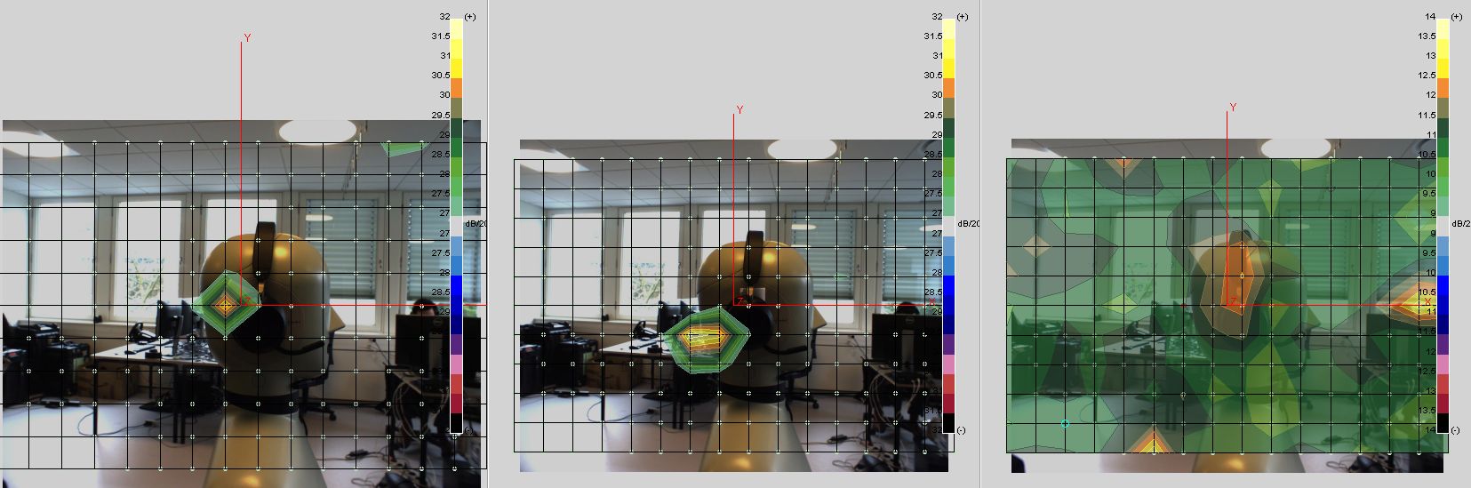
Measurement results - 2d beamforming
DAS beamforming center at 6300kHz, 1/3 octave bandwidth
Plot with 5dB dynamic range
Back Lose fit
Front Lose fit
Good fit

Slide 11
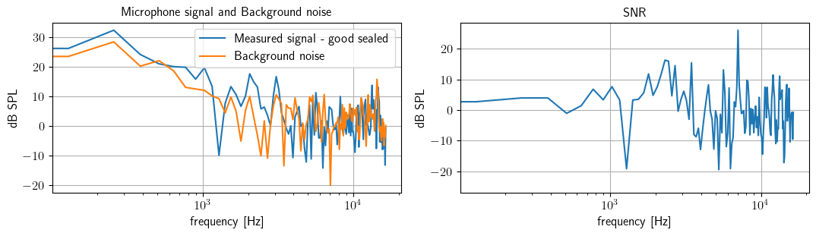
Measurement result - SNR
Background noise recorded after measurement
Bad signal noise ratio when headphone were good sealed

Slide 12
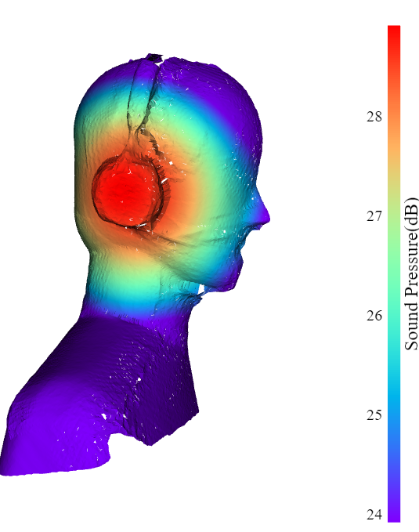
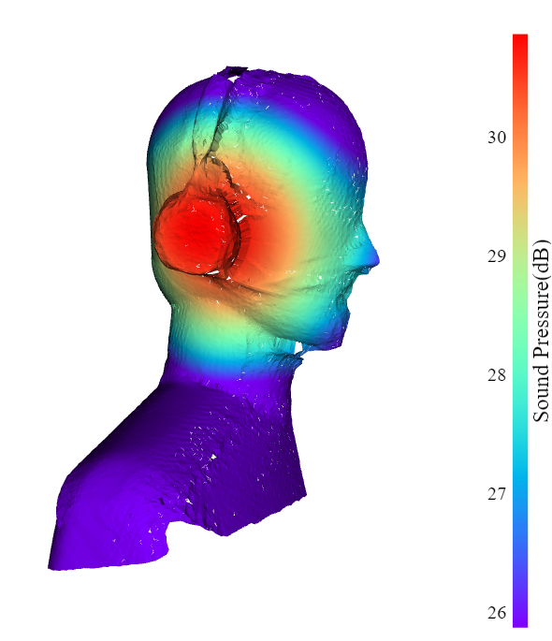
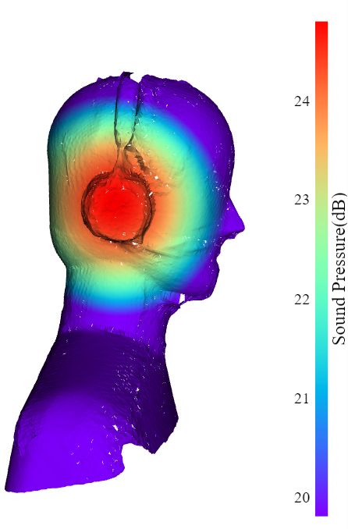
Measurement results – 3d beamforming
Delay and sum, calculated by BeamformerBase in Acoular
Frequency center at 3150kHz, 1/3 octave bandwidth
Plot with 5dB dynamic range
Background noise reduced – due to accurate distance information
Back Lose fit
Front Lose fit
Good fit

Slide 13
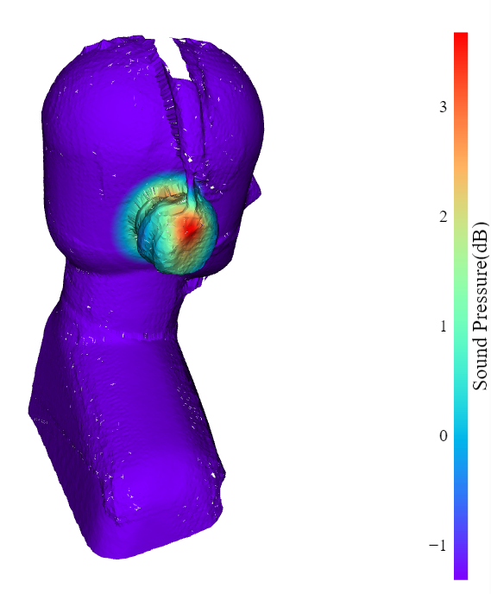
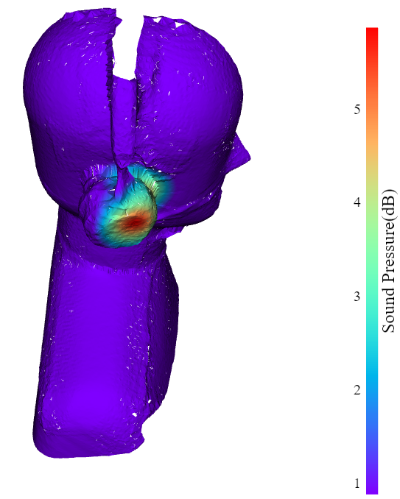
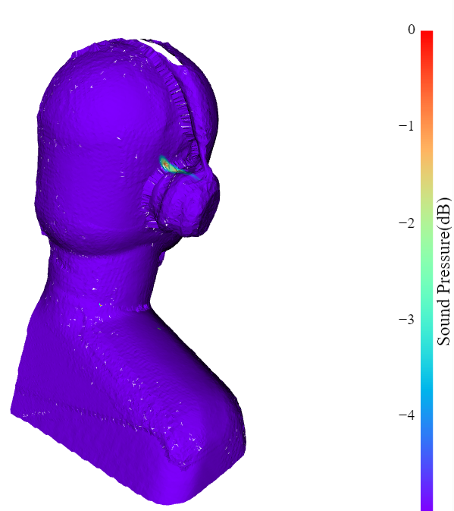
Measurement results – 3d beamforming
MUSIC, calculated by BeamformerMusic in Acoular
Frequency center at 3150kHz, 1/3 octave bandwidth
Plot with 5dB dynamic range
Background noise significantly reduced
Back Lose fit
Front Lose fit
Good fit

Slide 14
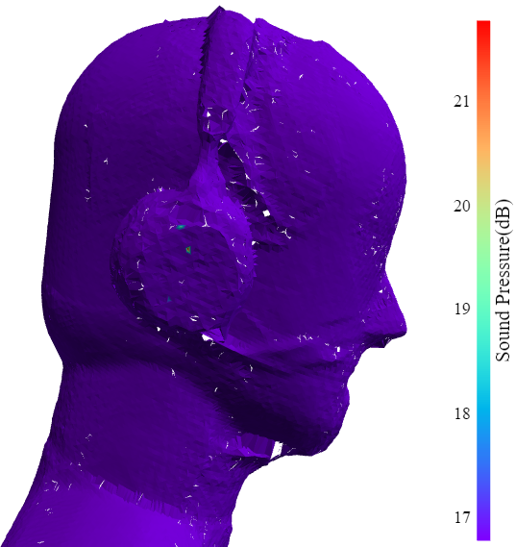
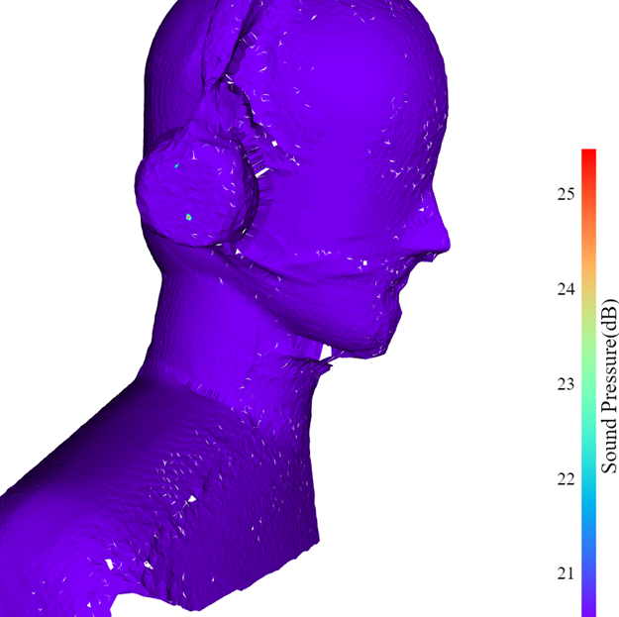
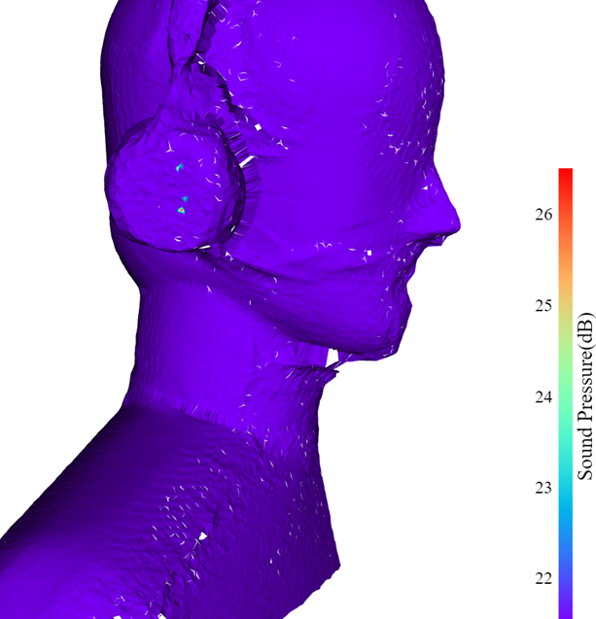
Measurement results – 3d beamforming
Clean-SC, calculated by BeamformerCleansc in Acoular
Frequency center at 3150kHz, 1/3 octave bandwidth
Plot with 5dB dynamic range
Background noise significantly reduced, but the localization might not realistic
Back Lose fit
Front Lose fit
Good fit

Slide 15
Measurement results – further demonstration
Frequency center – [250, 500, 1000, 2000, 4000, 8000]
Calculate condition: Good fit
Beamformer: MUSIC and CLEAN-sc
Purpose: find the radiation pattern and location under different frequency.

Slide 16
Summary
Advantages of 3D beamforming:
More intuitives results – relate with real object, easy to identify the sources
Reconstruct back to the actual surface, beamforming targets are related with realistic points.
Precise geometry alignment with the help of lidar scanning
Improved speed of geometry recreation - by open source Azure Kinect and Kinect fusion
Disadvantages:
More time consumption, compare with 2d beamforming
Can not measure the geometry ”in the shadow”
Heavy computational resources needed
Advanced algorithm may not accurate
Poor resolution under low frequency
No transient information
Future work
Improve SNR, better measurement environment
Realtime 3d beamforming with fixed scanner
Better algorithm
More Example cases
Demonstration of measurement and analysis as guidance for usage
Any inputs from Jabra??
16

Slide 17
Notes from meeting
Validation: loudspeaker – ground truth, 2d beamforming – proved solution - done
More method of validation: SONAH, Lazer meter, Nearby prob(but it’s a nearfield not a far field sound pressure)
Simulation – on progress
Optimization
Reciprocal measurement – but then the structure bone sound will affect the results
More realistic method
Current on going – improve the steering vector – based on the geometry normal

Slide 18
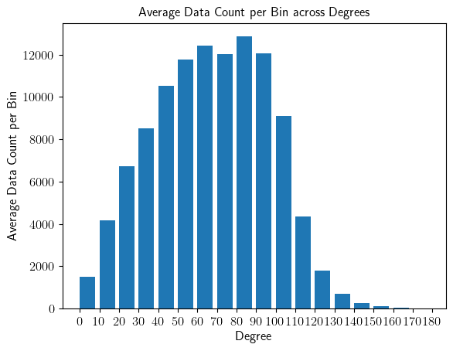
Simulation – reverse beamforming
One way to qualify the accuracy of reconstruction is reverse beamforming – calculate the radiation from the object surface based on the reconstructed sound pressure, get the sound pressure at each microphone’s position and compare the simulation with actual recordings.
Using Rayleigh integral in discrete form for calculation.
Not all mesh’s normal are vertical to the mic array plane. Source directivity are ignored during simulation. Environment noise are ignored as well
For large, shifted plane, and high frequency, the simulation will be exaggerated. Under low frequency, simulation will be underestimated.

Slide 19
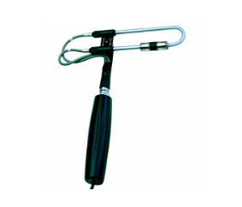
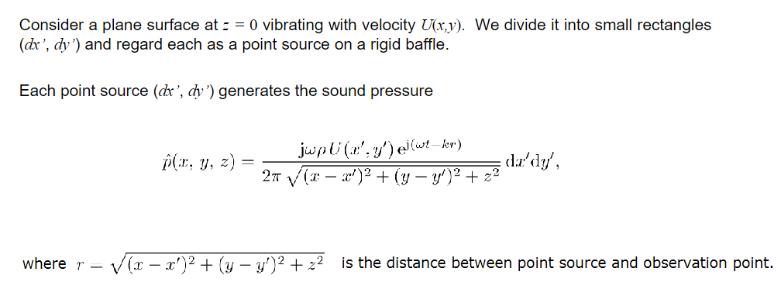
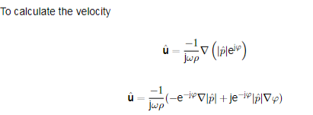
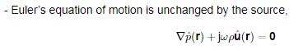
Simulation – Rayleigh integral
For calculate the Rayleigh integral, the surface vibration velocity is required.
Based on the Euler’s equation of motion, the surface vibration velocity can be calculated from the difference of two nearby pressure prob. In the case of Beamforming, it will be two nearest mesh points.
Discrete form Rayleigh are depending on velocity’s directivity.
B.C ??

Slide 20
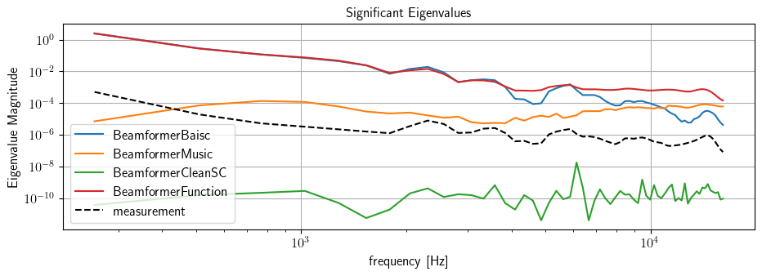
Simulation – reverse beamforming
One reason for such simulation is to reduce the results dimension. Because direct compare of pressure map on 3d object provides too much information, and by simulation to the microphone array and extract eigen values will significantly reduce the amount of data, yet still gives reasonable and comparable results.
For Jabra Evolve 75, with Good seal, the actual measurement and simulations under different solver’s result:
The result are not considering velocity’s directivity.

Slide 21
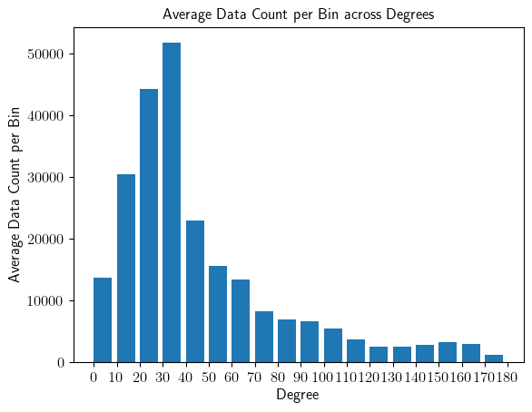
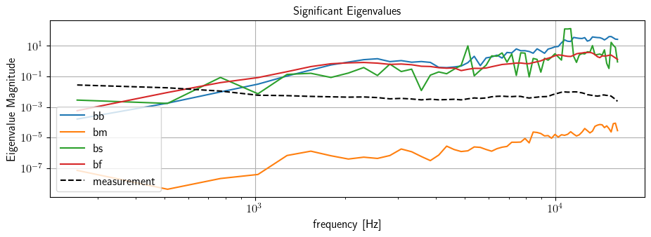
Loudspeaker measurement and simulation
It seems more “wrong” in music
Most of the mesh have nearly vertical normal to the mic plane
The calculation of plane vibration velocity u might be wrong.
Beamformer type:
bb – basic, bm – Music, bs – CleanSC, bf - function

Slide 22
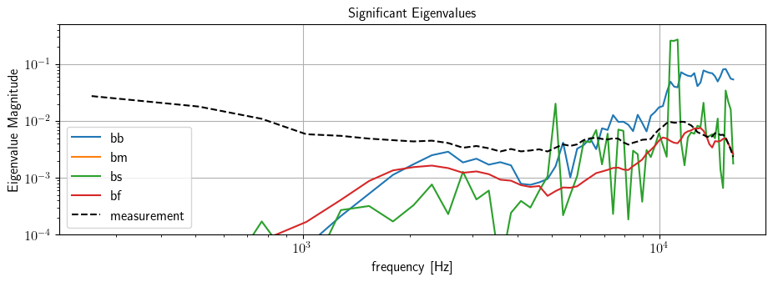
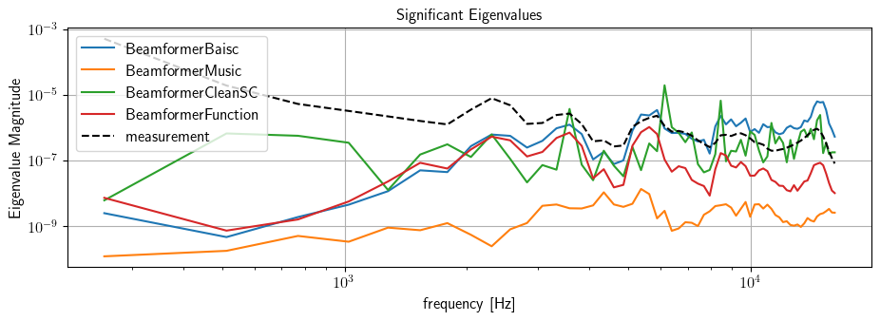
With a 2e-3 level adjustment to simulation
Loudspeaker
Simulation
Jabra Evolve 75 – good seal
The simulation result were affected by the size of source?
Simulation

Slide 23
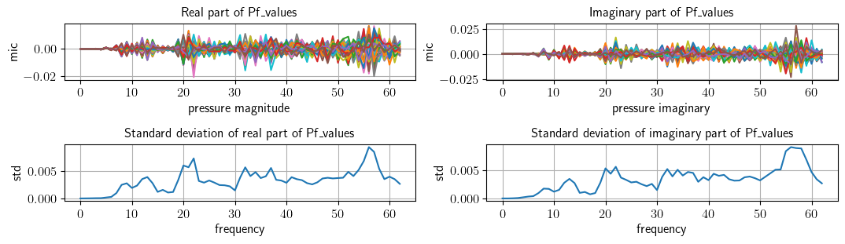
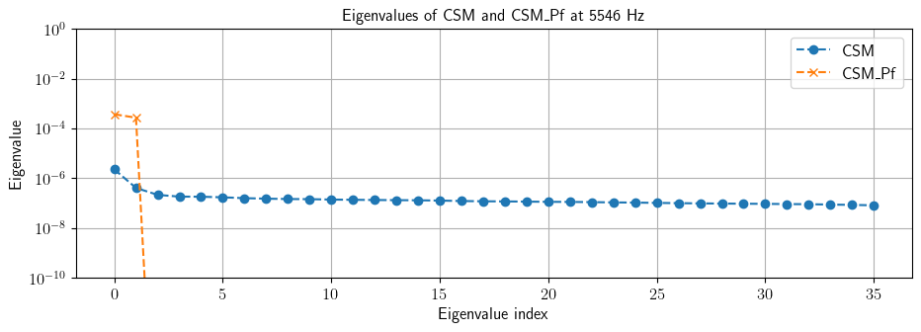
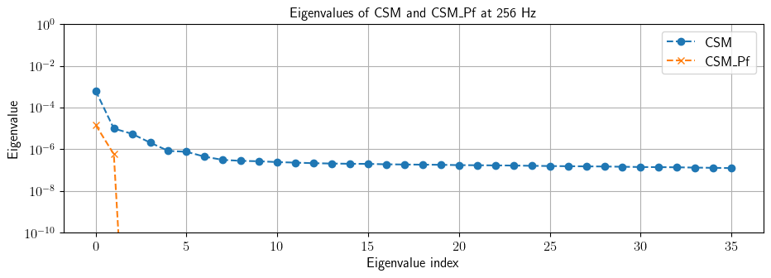
Simulation – eigenvalues

Slide 24
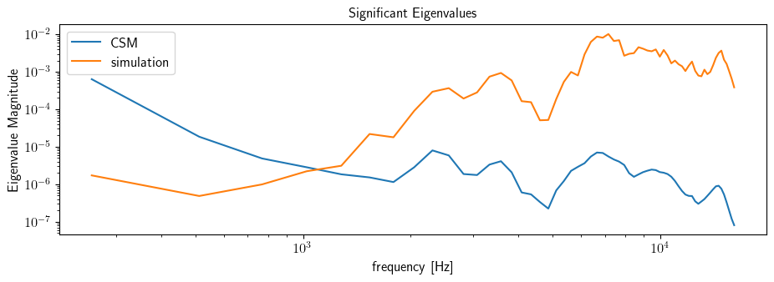
Simulation – reverse beamforming
One reason for such simulation is to reduce the results dimension. Because direct compare of pressure map on 3d object provides too much information, and by simulation to the microphone array and extract eigen values will significantly reduce the amount of data, yet still gives reasonable and comparable results.
For Jabra Evolve 75, with back lose, the actual measurement and simulations from Beamformer Base:

Slide 25
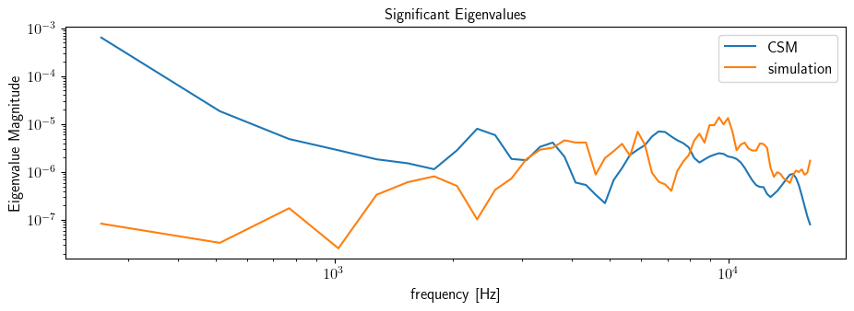
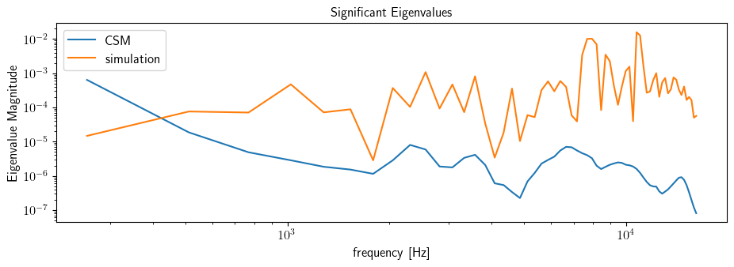
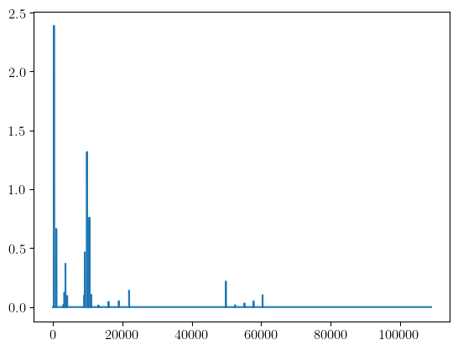
With same configuration, BeamformerMusic result:
With same configuration, BeamformerCleanSC result:

Slide 26
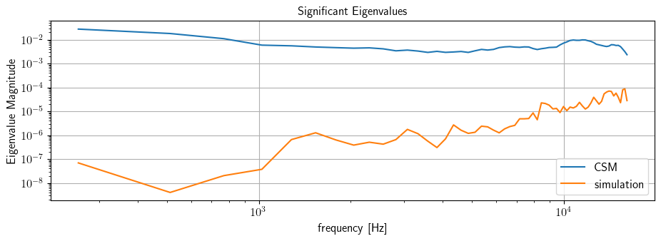
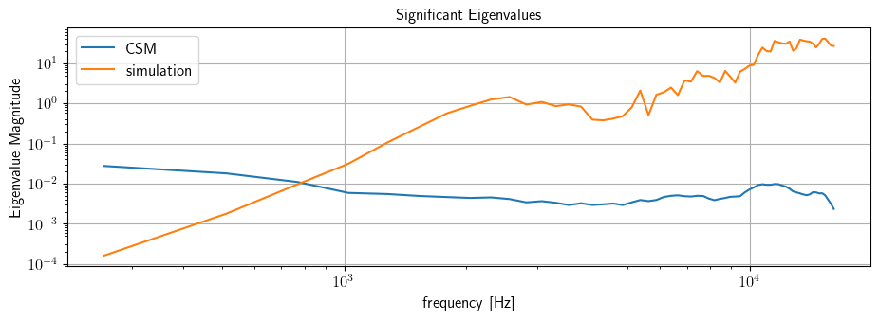

Loudspeaker measurement and simulation
It seems more “wrong” in music
Most of the meshs have nearly vertical normal to the mic plane
The calculation of plane vibration velocity u might be wrong.
BeamformerMusic
BeamformerBasic
BeamformerCleanSC

Slide 27


Functional Beamformer
Beamformer functional with different gamma input

Slide 28

Low frequency unmatched: the noise from background are taking over the estimation.

Slide 29

Ground Truth – ADAM A5x frequency response

Slide 30






Loudspeaker measurements - correlated
8000Hz – DAS – 5dB
5000Hz – DAS – 5dB
2500Hz – DAS – 5dB

Slide 31






Loudspeaker measurements - correlated
8000Hz – CleanSC – 5dB
5000Hz – DAS – 5dB
2500Hz – DAS – 5dB

Slide 32

(a) DAS (b) NNLS (c) CleanSC
8000Hz, 1833Hz bandwidth

Slide 33

(a) DAS (b) NNLS (c) CleanSC
5000Hz, 1157Hz bandwidth

Slide 34

(a) DAS (b) NNLS (c) CleanSC
5000Hz, 1157Hz bandwidth

Slide 35



Loudspeaker measurements - Uncorrelated
DAS NNLS CleanSC
8000Hz, 1833Hz bandwidth

Slide 36



Loudspeaker measurements - Uncorrelated
DAS NNLS CleanSC
5000Hz, 1157Hz bandwidth

Slide 37



Loudspeaker measurements - Uncorrelated
DAS NNLS CleanSC
2500Hz, 580Hz bandwidth

Slide 38




CleanSC, 1500Hz
MUSIC, 1500Hz
NNLS, 1500Hz

Slide 39
3D-Music, 1500Hz
CleanSC, 1500Hz
NNLS, 1500Hz

Slide 40



(a) DAS (b) Functional (c) Music
2500Hz

Slide 41



(a) DAS (b) Functional (c) Music

Slide 42



(a) DAS (b) Functional (c) Music

Slide 43


Slide 44



Slide 45


Slide 46



6000Hz, HP2, with and without foam

Slide 47




Example measurement Result
The high SPL in the result are related with the gap at top of tragus, due to pinna shape and rigidity
3D Delay-And-Sum (DAS) beamforming
A pair of headphones mounted on HATS
Reconstructed sound pressure field, DAS, at 4500Hz, 5dB dynamic range
2d DAS, from HBK's acoustic camera at the same frequency and the dynamic range ( 4500Hz, 5dB)
From the Lidar scan and 3d DAS beamforming
Low SPL
High SPL
47

Slide 48



Geometry allignment

